Slide 1
Live a healthy lifestyle
Feichao Qian
02/17/2016

Slide 2

How to live a healthy life?

Slide 3
How to live a healthy life?
Key idea:
Eat healthier and exercise regularly
Solution:
Make a plan and stick to it

Slide 4
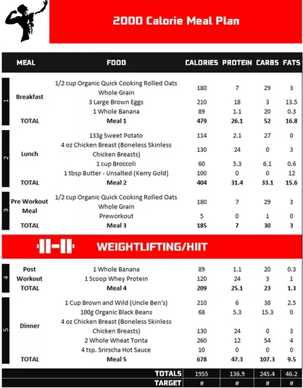
A 2000 Calorie Meal Plan:

Slide 5
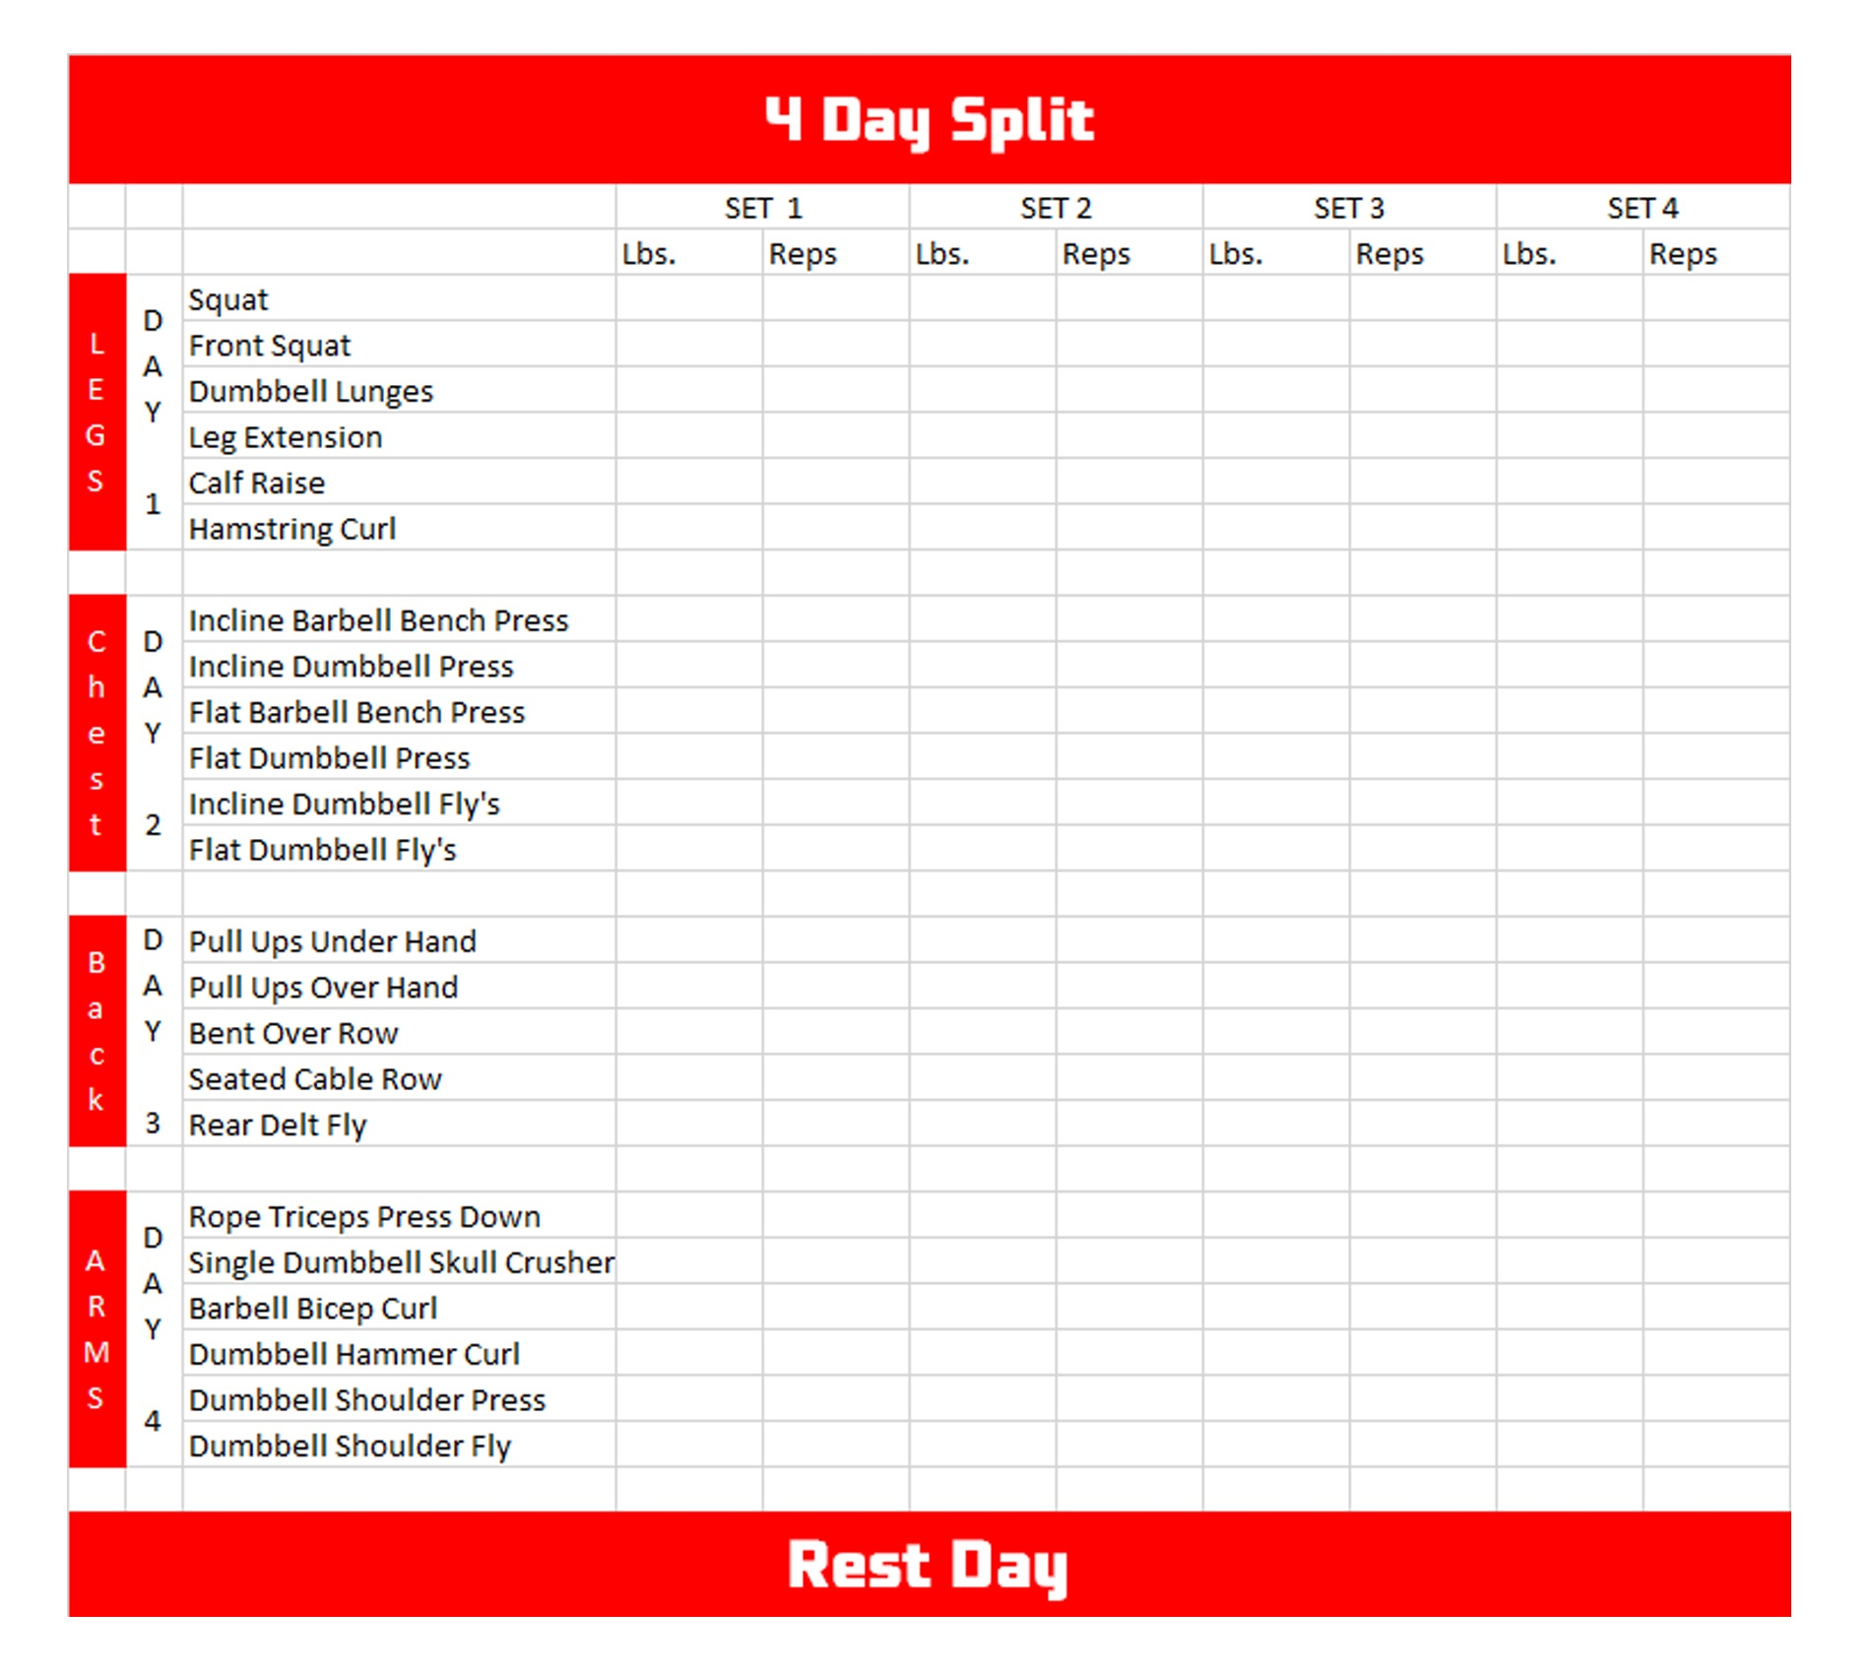
And a 4-day training plan:

Slide 6

Most common excuse: I have no time to exercise

Slide 7
Most common excuse: I have no time to exercise
Solutions:
get a complete workout in just under 30 minutes.
keep the intensity up
make sure to take as few breaks as possible.

Slide 8
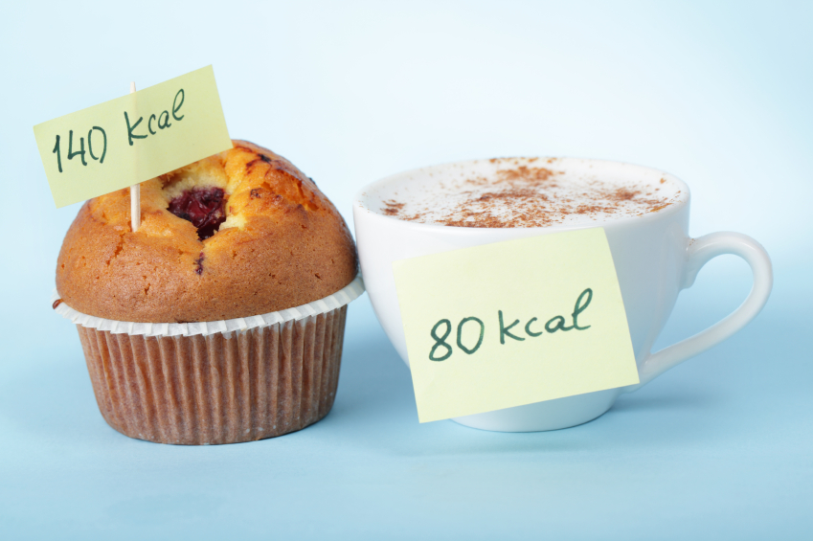
Another issue: how to make a plan?
Input some numbers at first
Take a picture when you eat
That’s all!

Slide 9
Last issue: I am too lazy to insist on the plan
Solutions:
Make it as a routine or a habit
Find a partner

Slide 10

The benefits you will get
Exercise Stimulates Brain Cell Development.
Exercise Improves Memory Retention.
Exercise Increases Focus and Concentration.
Exercise Boosts Mood.
Exercise Relieves Stress.
…

Slide 11

To summarize – Eat lean, Train mean :)

